Slide 1
Week-01
Lesson-01 Languages of Data Science

Slide 2
Languages are
Basic - Python , R , SQL
Commercial- Scala, Java, C++, and Julia
Use Case Based- Javascript, PHP, Go, Ruby, and Visual Basic

Slide 3
Roles in Data Science
Business Analyst
Database Engineer
Data Analyst
Data Engineer
Data Scientist
Research Scientist
Software Engineer
Statistician
Product Manager
Project Manager

Slide 4
Introduction to Python
If you already know how to program, then Python is great for you because it uses clear, readable syntax.
if you want to learn to program,
80% of data professionals worldwide use Python.
Python is useful for many situations, including data science, AI and machine learning, web development, and IoT devices like the Raspberry Pi.
Large organizations that use Python heavily include IBM, Wikipedia, Google, Yahoo!, CERN, NASA, Facebook, Amazon, Instagram, Spotify, and Reddit.

Slide 5
What makes Python great
General Purpose Language
Large Standard library
For Data Science:
Scientific Computing libraries like Pandas, NumPy, Scipy, and matplotlib
For artificial intelligence, it has TensorFlow, PyTorch, Keras, and Scikit-learn.
Python can also be used for Natural Language Processing (NLP) using the Natural Language Toolkit (NLTK).
Another great selling point is the Python community, which has a well documented history of paving the way for diversity and inclusion efforts in the tech industry as a whole.

Slide 6
Introduction to R language
Python is Open Source, R is Free Software,
Similarities:
commonly refer to the same set of licenses
Both open source and free software support collaboration
In Many Cases These terms can be used Interchangeably
Differences:
The Open Source Initiative (OSI) champions open source while the Free Software Foundation (FSF) defines free software.
Open source is more business focused, while free software is more focused on a set of values.

Slide 7
Who is R For?
It's most often used by statisticians, mathematicians, and data miners for developing statistical software, graphing, and data analysis.
The language’s array-oriented syntax makes it easier to translate from math to code, especially for someone with no or minimal programming background.
According to Kaggle’s Data Science and Machine Learning Survey, most folks learn R when they're a few years into their data science career, but it remains a welcoming language to those who don’t have a software programming background.
R is popular in academia but companies that use R include IBM, Google, Facebook, Microsoft, Bank of America, Ford, TechCrunch, Uber, and Trulia.

Slide 8
What makes R great :
● R has become the world’s largest repository of statistical knowledge.
● As of 2018, R has more than 15,000 publicly released packages, making it possible to conduct complex exploratory data analysis.
● R integrates well with other computer languages, such as C++, Java, C, .Net, and Python.
● Common mathematical operations such as matrix multiplication work straight out of the box.
● R has stronger object-oriented programming facilities than most statistical omputing languages.

Slide 9
Introduction to SQL
it's much older than Python and R, by about 20 years, having first appeared in 1974.
SQL was developed at IBM!
This language is useful in handling structured data; that is, the data incorporating relations among entities and variables.
SQL was designed for managing data in relational databases.
because it's so pervasive and easy to use, SQL interfaces for many NoSQL and big data repositories have also been developed.
The SQL language is subdivided into several language elements, including clauses, expressions, predicates, queries, and statements.

Slide 10
what makes SQL great?
Knowing SQL will help you do many different jobs in data science, including business and data analyst, and it's a must in data engineering.
When performing operations with SQL, you access the data directly. There's no need to copy it beforehand. This can speed up workflow executions considerably.
SQL is the interpreter between you and the database.
SQL is an American National Standards Institute, or "ANSI," standard, which means if you learn SQL and use it with one database, you will be able to easily apply that SQL knowledge to many other databases.
There are many different SQL databases available, including MySQL, IBM Db2, PostgreSQL, Apache OpenOffice Base, SQLite, Oracle, MariaDB, Microsoft SQL Server, and more.
The syntax of the SQL you write might change a little bit based on the relational database management system you’re using.
If you are looking to learn SQL you would be best served to focus on a specific relational database and then plug into the community for that specific platform. There are also many great introductory courses on SQL available!

Slide 11
Other Languages
Scala, Java, C++, and Julia are probably the most traditional data science languages on this slide.
But JavaScript, PHP, Go, Ruby, Visual Basic, and others have all found their place in the data science community as well

Slide 12
Java
Java is a tried-and-true general-purpose object oriented programming language.
It's been widely adopted in the enterprise space and is designed to be fast and scalable.
Java applications are compiled to bytecode and run on the Java Virtual Machine, or "JVM."
For Data Science
include Weka, for data mining; Java-ML, which is a machine learning library; Apache MLlib, which makes machine learning scalable; and Deeplearning4j, for deep learning.
Apache Hadoop is another Java-built application. It manages data processing and storage for big data applications running in clustered systems.

Slide 13
Scala
Scala is a general-purpose programming language that provides support for functional programming and a strong static type system.
Many of the design decisions in the construction of the Scala language were made to address criticisms of Java.
Scala is also interoperable with Java, as it runs on the JVM.
The name "Scala" is a combination of "scalable" and "language." This language is designed to grow along with the demands of its users.
For data science,
the most popular program built using Scala is Apache Spark. Spark is a fast and general-purpose cluster computing system. It provides APIs that make parallel jobs easy to write, and an optimized engine that supports general computation graphs.
Spark includes Shark, which is a query engine; MLlib, for machine learning; GraphX, for graph processing; and Spark Streaming.
Apache Spark was designed to be faster than Hadoop.

Slide 14
C++
C++ is a general-purpose programming language. It is an extension of the C programming language, or "C with Classes.”
C++ improves processing speed, enables system programming, and provides broader control over the software application.
Many organizations that use Python or other high-level languages for data analysis and exploratory tasks still rely on C++ to develop programs that feed that data to customers in real-time.
For data science,
a popular deep learning library for dataflow called TensorFlow was built with C++.
But while C++ is the foundation of TensorFlow, it runs on a Python interface, so you don’t need to know C++ to use it.
MongoDB, a NoSQL database for big data management, was built with C++.
Caffe is a deep learning algorithm repository built with C++, with Python and MATLAB bindings.

Slide 15
JavaScript
A core technology for the World Wide Web, JavaScript is a general-purpose language that extended beyond the browser with the creation of Node.js and other server-side approaches.
Javascript is NOT related to the Java language.
For data science,
the most popular implementation is undoubtedly TensorFlow.js. TensorFlow.js makes machine learning and deep learning possible in Node.js as well as in the browser.
TensorFlow.js was also adopted by other open source libraries, including brain.js and machinelearn.js.
The R-js project is another great implementation of JavaScript for data science.
R-js has re-written linear algebra specifications from the R Language into Typescript.
This re-write will provide a foundation for other projects to implement more powerful math base frameworks like Numpy and SciPy of Python.
Typescript is a superset of JavaScript.

Slide 16
Julia
Julia was designed at MIT for high-performance numerical analysis and computational science.
It provides speedy development like Python or R, while producing programs that run as fast as C or Fortran programs.
Julia is compiled, which means that the code is executed directly on the processor as executable code; it calls C, Go, Java, MATLAB, R, Fortran, and Python libraries; and has refined parallelism.
The Julia language is relatively new, having been written in 2012, but it has a lot of promise for future impact on the data science industry.
JuliaDB is a particularly useful application of Julia for data science. It's a package for working with large persistent data sets.

Slide 17
Week-01
Lesson-02 Data Science Tools

Slide 18
Categories of Data Science
Data Management
Data Management is the process of persisting and retrieving data.
Data Integration and Transformation
often referred to as Extract, Transform, and Load, or “ETL,
process of retrieving data from remote data anagement systems
Data Visualization
part of an initial data exploration process, as well as being part of a final Deliverable
Model Building
process of creating a machine learning or deep learning model using an appropriate algorithm with a lot of data
Model deployment
makes such a machine learning or deep learning model available to third-party applications
Model monitoring and assessment
ensures continuous performance quality checks on the deployed models.
uses versioning and other collaborative features to facilitate teamwork.
Data asset management
brings the same versioning and collaborative components to data
also supports replication, backup, and access right management.
These checks are for accuracy, fairness, and adversarial robustness.
Code asset Management
Development environments
commonly known as Integrated Development Environments, or “IDEs”,
are tools that help the data scientist to implement, execute, test, and deploy their work.
Execution environments
visual tooling
tooling components, either partially or completely.
are tools where data preprocessing, model training, and deployment take place.
available that covers all the previous

Slide 19
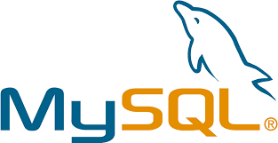

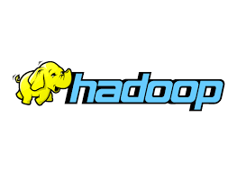



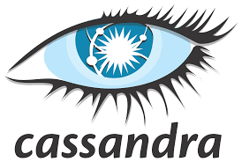
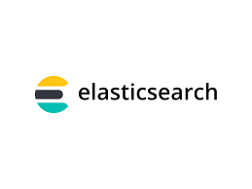
data management
Open Source | NoSQL DataBases | File Based System

Slide 20
Data Integration and Transformation tools
creating a search index for fast document retrieval the task of data integration and transformation in the classic data warehousing world is called ETL which stands for extract transform and load
these days data scientists often proposed the term ELT extract load transform stressing the fact that data is dumped somewhere and
the data engineer or data scientists themself is responsible for data another term for this process has now emerged data refining and cleaning here are the most widely used open source data integration and transformation tools

Slide 21

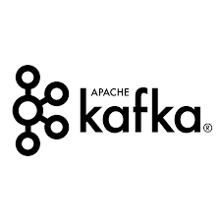
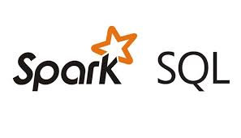


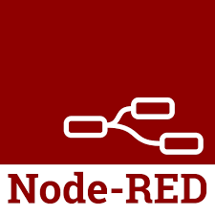
Apache airflow originally created by Airbnb cube flow which enables you to execute data science pipelines on top of kubernetes
Apache Kafka which originated from LinkedIn Apache
NiFi I which delivers a very nice visual editor Apache sparks SQL which enables you to use ANSI SQL and scales up to compute clusters of thousands of nodes and node read which also provides a visual editor node read consumes so little in resources that it even runs on small devices like a Raspberry Pi .

Slide 22


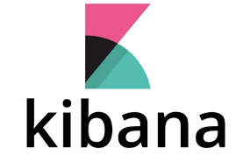
data visualization tools
we have to distinguish between programming libraries where you need to use code and tools that contain a user interface the most popular libraries are covered in the next videos
a similar approach uses hue which can create visualizations from SQL queries
Kibana a data exploration and visualization web application is limited to elastic search the data provider
Apache superset is a data exploration and visualization web application

Slide 23
model deployment
is extremely important once you've created a machine learning model capable of predicting some key aspects of the future you should make that model consumable by other developers and turn it into an API .
Apache prediction IO currently only supports Apache spark ml models for deployment but support for all sorts of other libraries is on the roadmap .
Seldon is an interesting product since it supports nearly every framework including tensorflow Apache spark ml R and scikit-learn Selden can run on top of kubernetes and Red Hat OpenShift
another way to deploy spark ml models is using M leap finally tensorflow can serve any of its models using the tensorflow service you can deploy to an embedded device like a Raspberry Pi or a smartphone using tensorflow light and even deploy to a web browser using tensorflow .js

Slide 24
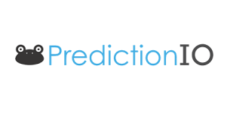

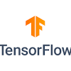


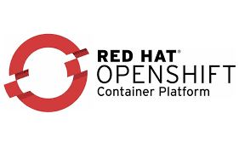
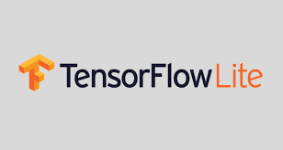
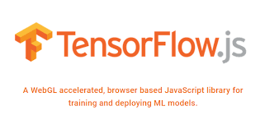

Slide 25
model monitoring
once you've deployed a machine learning model you need to keep track of its prediction performance as new data arrives in order to maintain outdated models
following are some examples of model monitoring tools
model DB is a machine model metadata base where information about the models are stored and can be queried it natively supports
Apache spark ml pipelines and scikit-learn a generic multi-purpose tool called prometheus is also widely used for machine learning model monitoring although it's not specifically made for this purpose model performance is not exclusively measured through accuracy model bias against protected groups like gender or race is also important
the IBM AI fairness 360 open source toolkit does exactly this it detects and mitigates against bias in machine learning models machine learning models especially neural network based deep learning models can be subject to adversarial attacks where an attacker tries to fool the model with manipulated data or by manipulating the model itself
the IBM adversarial robustness 360 toolbox can be used to detect vulnerability to adversarial attacks and help make the model more robust machine learning models often consider to be a black box

Slide 26
that applies some mysterious magic the IBM AIX plane ability 360 toolkit makes the machine learning process more understandable by finding similar examples within a data set that can be presented to a user for manual comparison
the IBM AIX plane ability 360 toolkit can also illustrate training for a simpler machine learning model by explaining how different input variables affect the final decision of the model options

Slide 27
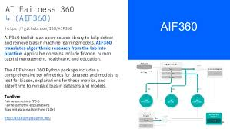
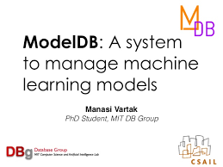

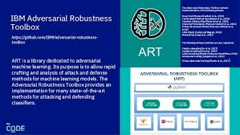


Slide 28
code asset management tools
have been greatly simplified for code asset management also referred to as version management or version control
git is now the standard multiple services have emerged to support kit with the most prominent being github which provides hosting for software development version management the runner-up is definitely get lab which has the advantage of being a fully open source platform that you can host and manage yourself
bitbucket data asset management also known as data governance or data lineage is another crucial part of enterprise grade data science data has to be versioned and annotated with metadata
Apache Atlas is a tool that supports this task another interesting project Oh dpi Egeria is managed through the Linux Foundation and is an open ecosystem it offers a set of open api's types and interchange protocols that metadata repositories use to share and exchange data finally
Kyllo is an open source data Lake management software platform that provides extensive support for a wide range of data asset management tasks

Slide 29
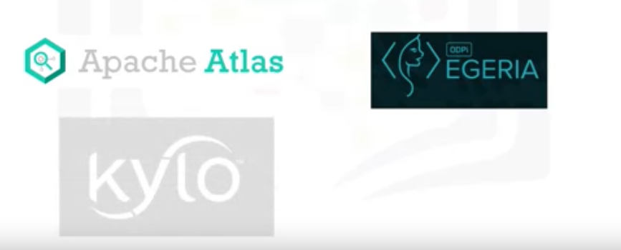


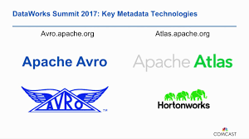

Slide 30
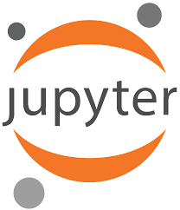
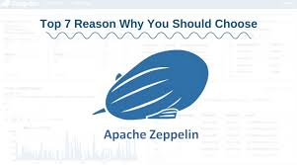
Development environment
Jupyter Jupyter first emerged as a tool for interactive Python programming it now supports more than a hundred different programming languages through “kernels.”
Kernels shouldn’t be confused with operating system kernels. Jupyter kernels are encapsulating the different interactive interpreters for the different programming languages. A key property of Jupyter Notebooks is the ability to unify documentation, code, output from the code, shell commands, and visualizations into a single document.
JupyterLab is the next generation of Jupyter Notebooks and in the long term, will actually replace Jupyter Notebooks. The architectural changes being introduced in JupyterLab makes Jupyter more modern and modular. From a user’s perspective, the main difference introduced by JupyterLab is the ability to open different types of files, including Jupyter Notebooks, data, and terminals. You can then arrange these files on the canvas.
Although Apache Zeppelin has been fully reimplemented, it’s inspired by Jupyter Notebooks and provides a similar experience. One key differentiator is the integrated plotting capability.

Slide 31
In Jupyter Notebooks, you are required touse external libraries in Apache Zeppelin and plotting doesn’t require coding
You can also extend these capabilities byusing additional libraries.

Slide 32


RStudio is one of the oldest development environments for statistics and data science, having been introduced in 2011.
It exclusively runs R and all associated R libraries. However, Python development is possible and R is therefore tightly integrated into this tool to provide an optimal user experience.
RStudio unifies programming, execution, debugging, remote data access, data exploration, and visualization into a single tool.

Slide 33

Spyder
Spyder tries to mimic the behaviour of Rstudio to bring its functionality to the Python world.
Although Spyder does not have the same level of functionality as RStudio, data scientists do consider it an alternative. But in the Python world, Jupyter is used more frequently.

Slide 34

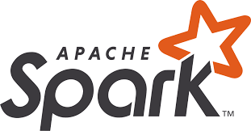
open source data integration
The well known cluster-computing framework Apache Spark is among the most active
Apache projects and is used across all industries, including in many Fortune 500 companies. The key property of Apache Spark is linear scalability. This means, if you double the number of servers in a cluster, you’ll also roughly double its performance. After Apache Spark began to gain market share,
Apache Flink was created. The key difference between Apache Spark and Apache Flink is that Apache Spark is a batch data processing engine, capable of processing huge amounts of data file by file.
Apache Flink, on the other hand is a stream processing image, with its main focus on processing real-time data streams.

Slide 35

Although engine supports both data processing paradigms, Apache Spark is usually the choice in most use cases.’
“Ray,” which has a clear focus on large-scale deep learning model training

Slide 36
Fully Integrated And Visual tools
With these tools, no programming knowledge is necessary.
Most important tasks are supported by these tools; these tasks include
data integration,
transformation,
data visualization, and
Model building.

Slide 37
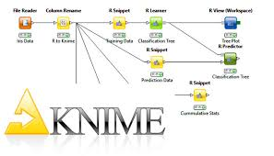
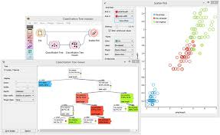
KNIME originated at the University of Konstanz in 2004.
KNIME has a visual user interface with drag-and-drop capabilities.
It also has built-in visualization capabilities.
Knime can be be extended by programming in R and Python, and has connectors to Apache Spark
Orange. It’s less flexible than KNIME, but easierto use.

Slide 38
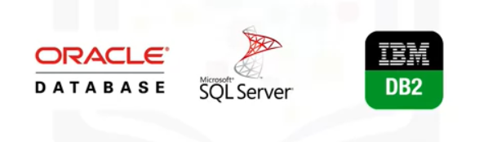
Commercial Data Science Tools
data management
Oracle
SQL Server
IBM DB2
those three data management products are still considered the industry-standardThey won’t disappear in the near future

Slide 39
Data is at the heart of every organization, and the availability of commercial supports plays a major role. Commercial supports are delivered directly from software vendors, influential partners, and support networks. When we focus on commercial data integration tools,
we’re talking about “extract, transform, and load,” or “ETL” tools.

Slide 40
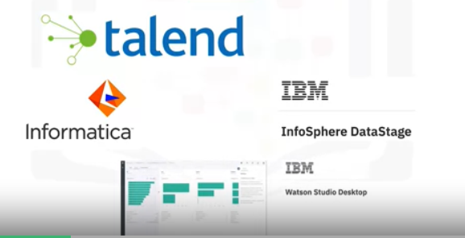
Commerical Tools
Data Integration And Transformation
Informatica Power center and IBM InfoSphere DataStage are the leaders
followed by products from SAP,Oracle, SAS, Talend, and Microsoft.
These tools support design and deployment of ETL data-processing pipelines through a graphical interface they also provide connectors to most of the commercial and open source target information systems.
Finally, Watson Studio Desktop includes a component called Data Refinery, which enables the defining and execution of data integration processes in a spreadsheet style.

Slide 41
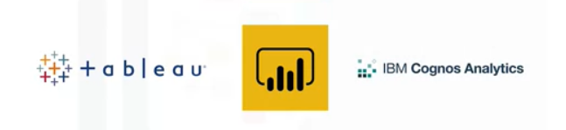
Commercial Tools
Data Visualization
Their main focus is to create visually attractiveand easy-to-understand reports and live dashboards.
The most prominent commercial examples are:Tableau, Microsoft Power BI, and IBM Cognos Analytics.

Slide 42
Another type of visualization targets data scientists rather than regular users. A sample problem might be “How can different columns in a table relate to each other?”
This type of functionality is contained in Watson Studio Desktop.

Slide 43
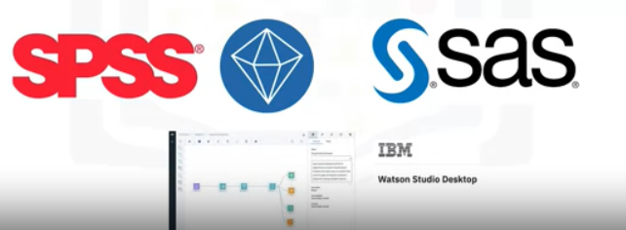
Commerical Tools
Model Building
The most prominent of these types of productsare: SPSS Modeler and SAS Enterprise Miner.
In addition, A version of SPSS Modeler is also available i based on the cloud version of the tool.n Watson Studio Desktop,

Slide 44
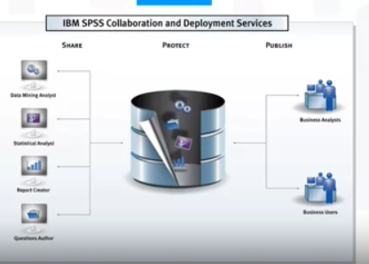
Commercial Tools
Model Deployment
model deployment is tightly integrated in the model building process.
This diagram shows an example of the SPSS Collaboration and Deployment Services which are used to deploy any type of asset created by the SPSS software tools suite.
Other vendors use the same type of process.
Commercial software can also export models in an open format.
For example, SPSS Modeler supports the exporting of models as Predictive Model Markup Language, or PMML which can be read by many other commercial and open software packages.

Slide 45
Model monitoring
is a new discipline and thereare currently no relevant commercial tools available.
As a result, open source is the first choice.
The same is true for code asset management.
Open source with Git and GitHub is the effective standard.

Slide 46
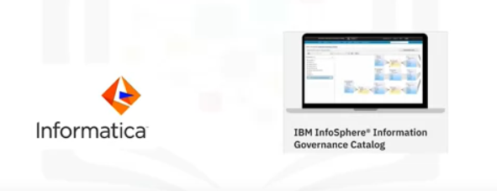
Data Asset Management
Data asset management, often called data governanceor data lineage, is a crucial part of enterprise grade data science.
Data must be versioned and annotated usingmetadata. Vendors, including Informatica EnterpriseData Governance and IBM, provide tools for these specific tasks.
The IBM InfoSphere Information GovernanceCatalog covers functions like data dictionary, which facilitates discovery of data assets.

Slide 47
The data lineage also includes a referenceto the actual source data. Rules and policies can be added to reflectcomplex regulatory and business requirements for data privacy and retention

Slide 48
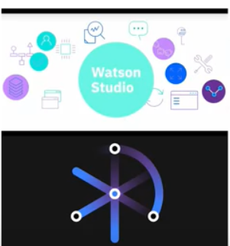
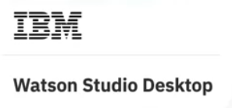
Watson Studio is a fully integrated development environment for data scientists
It’s usually consumed through the cloud.
Watson Studio Desktop combines Jupyter Notebooks with graphical tools to maximize data scientists’ performance.
Watson Studio, together with Watson Open Scale, is a fully integrated tool covering the full data Science life cycle and all the tasks we’ve discussed previously.

Slide 49

just keep in mind that they can be deployed in a local data center on top of Kubernetes or RedHat OpenShift.
Another example of a fully integrated commercial tool is H2O Driverless AI, which covers the complete data science life cycle. In this lesson, you’ve learned how most common data science tasks are supported by commercial tools.

Slide 50
Week-01
Lesson-03 Packages, APIs, DataSets and Models

Slide 51
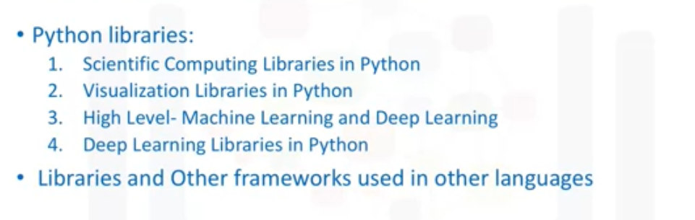
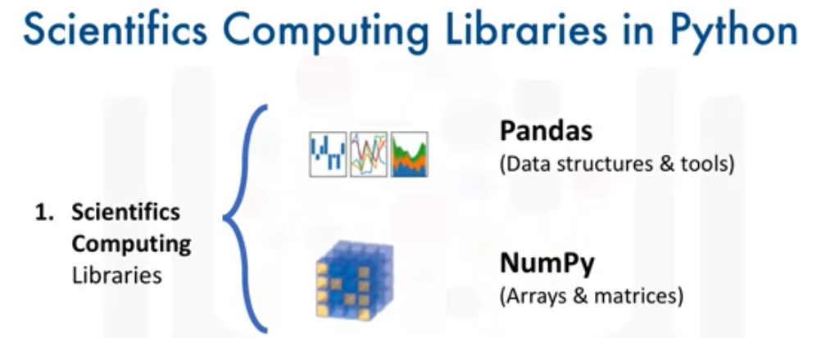
Libraries for Data Science
Python Lib:

Slide 52
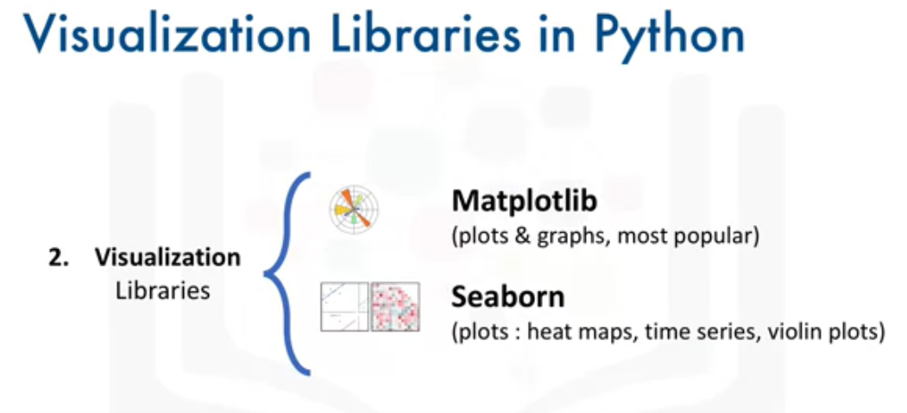
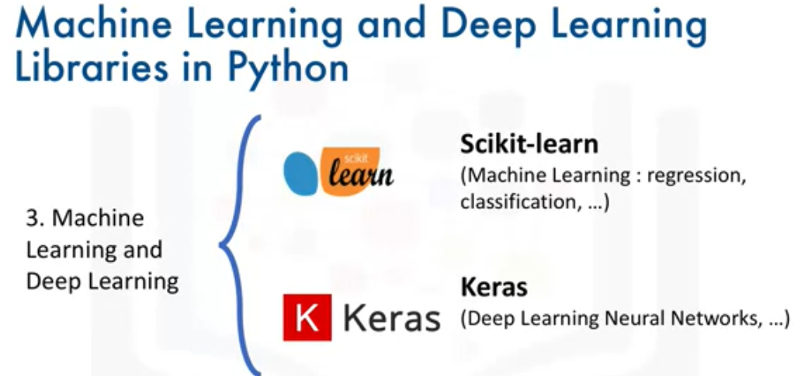

Slide 53
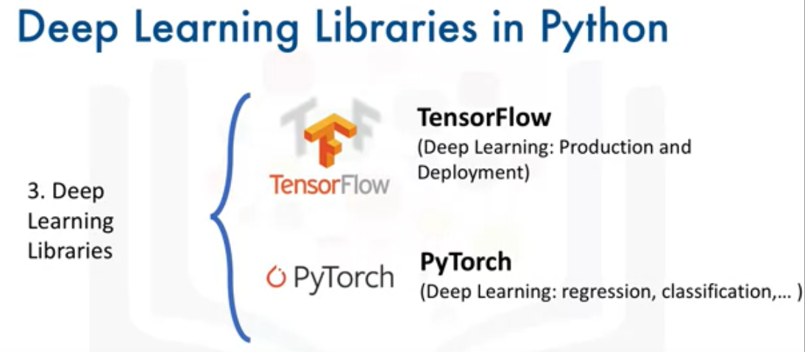

Slide 54
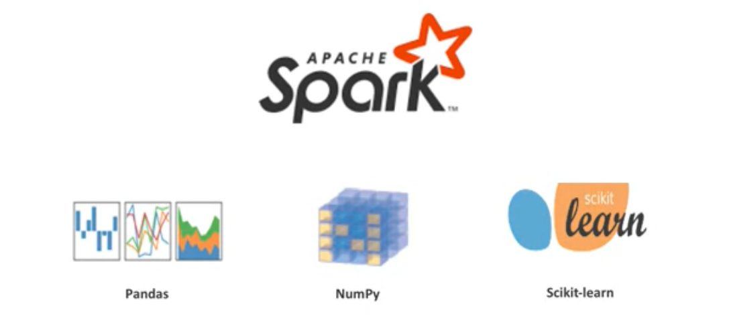
Apache Spark is a general-purpose cluster-computing framework that enables you to process data using compute clusters.
This means that you process data in parallel, using multiple computers simultaneously.
The Spark library has similar functionality as Pandas Numpy Scikit-learn
Apache Spark data processing jobs can use Python R Scala, or SQL

Slide 55
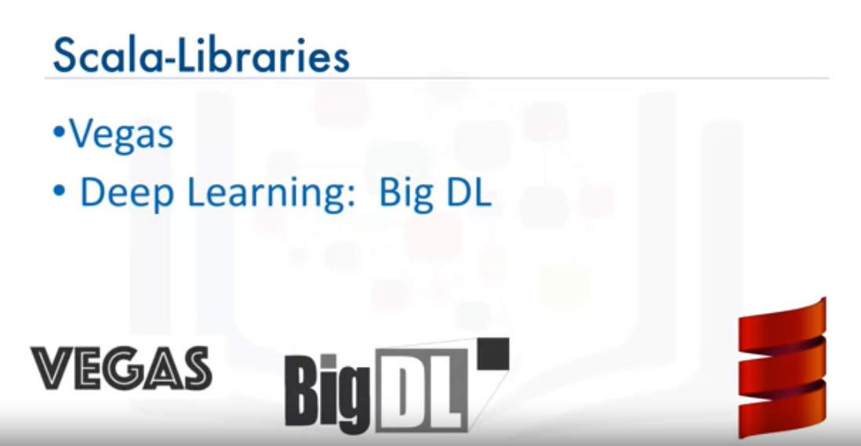
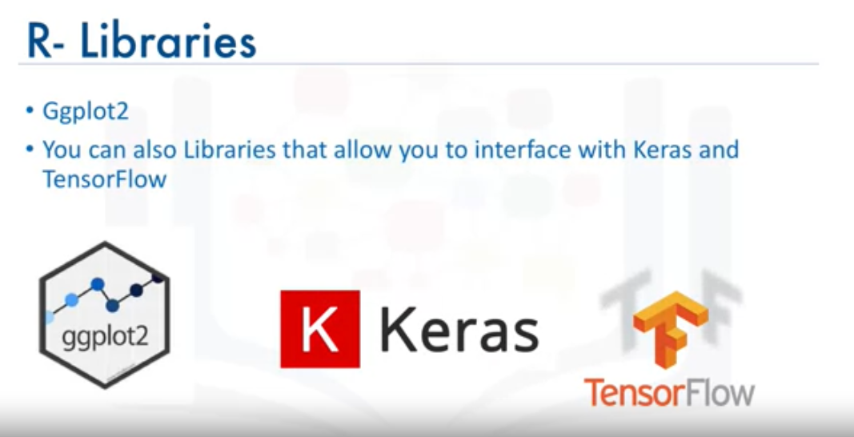

Slide 56
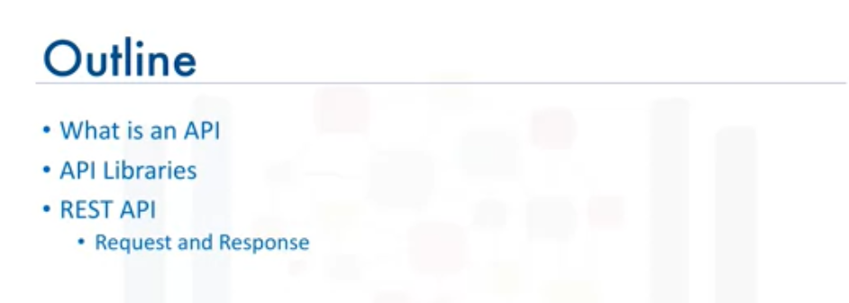
Application Package Interface (API)

Slide 57
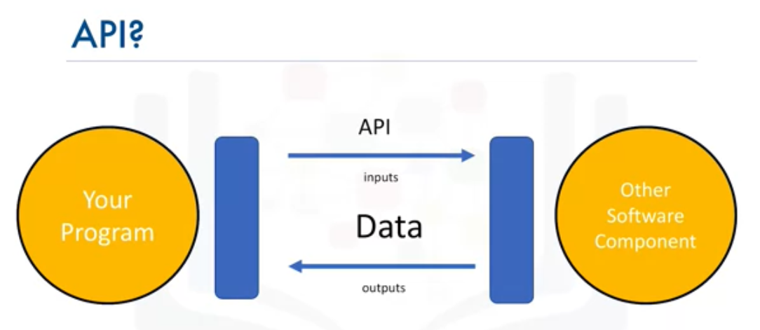
An API lets two pieces of software talk to each other.

Slide 58
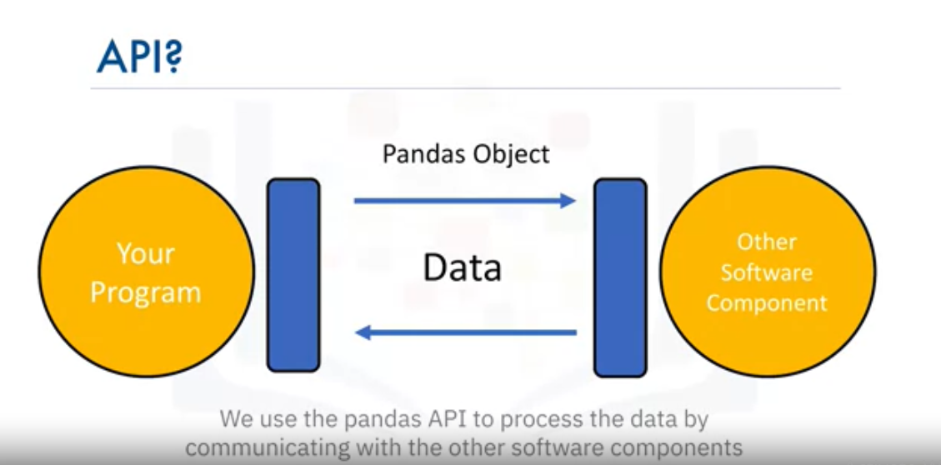
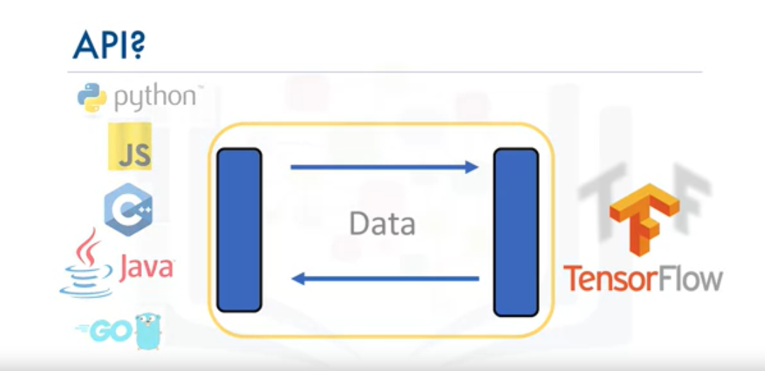

Slide 59
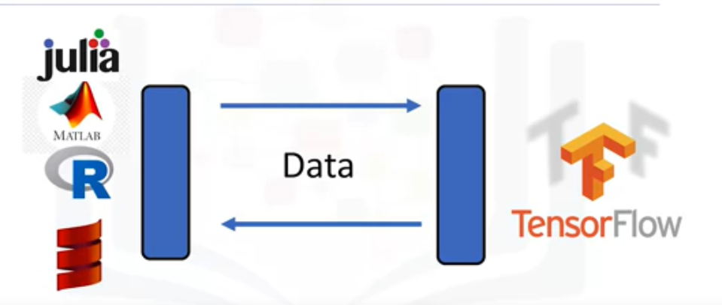
There are also multiple volunteer-developed APIs for TensorFlow; for example Julia MATLAB R Scala And many more.

Slide 60
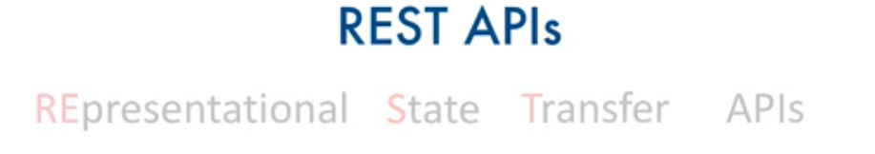
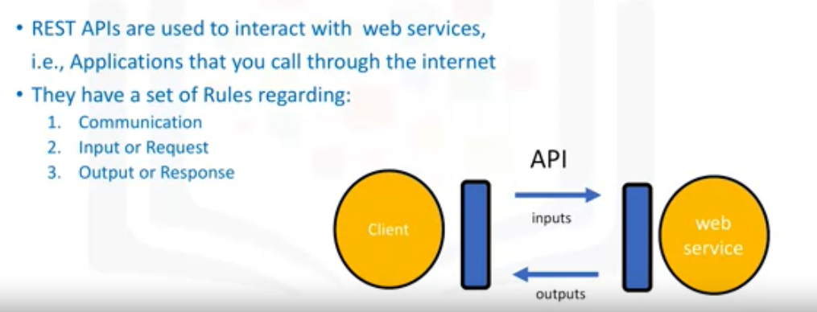
They enable you to communicate using the internet, taking advantage of storage, greater data access, artificial intelligence algorithms, and many other resources.

Slide 61
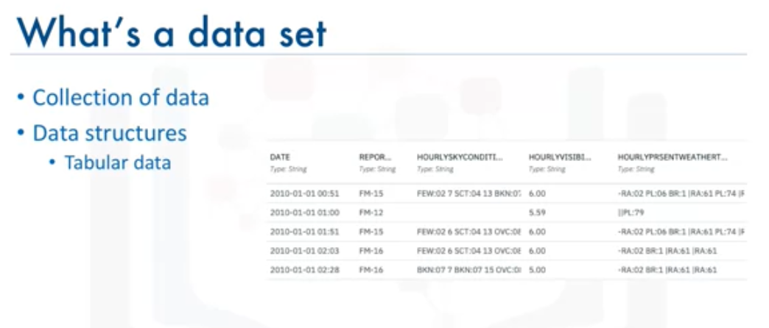
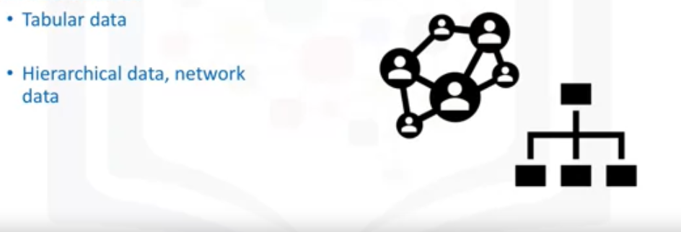
A CSV file is a delimited text file where each line represents a row and data values are separated by a comma.

Slide 62
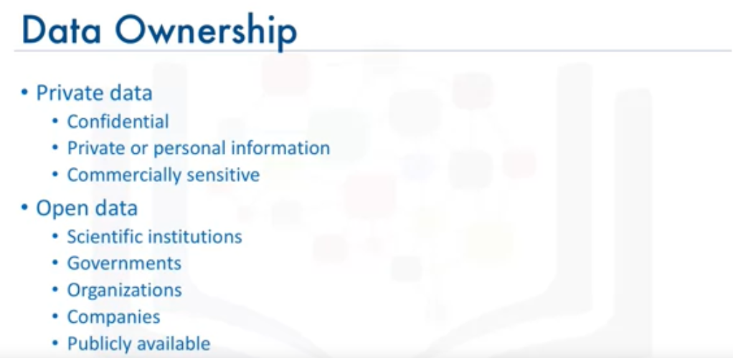
For example, the United Nations and federal and municipal governments around the world have published many data sets on their websites, covering the economy, society, healthcare, transportation, environment, and much more. Access to these and other open data sets enable data scientists, researchers, analysts, and others to uncover previously unknown and potentially useful insights.

Slide 63
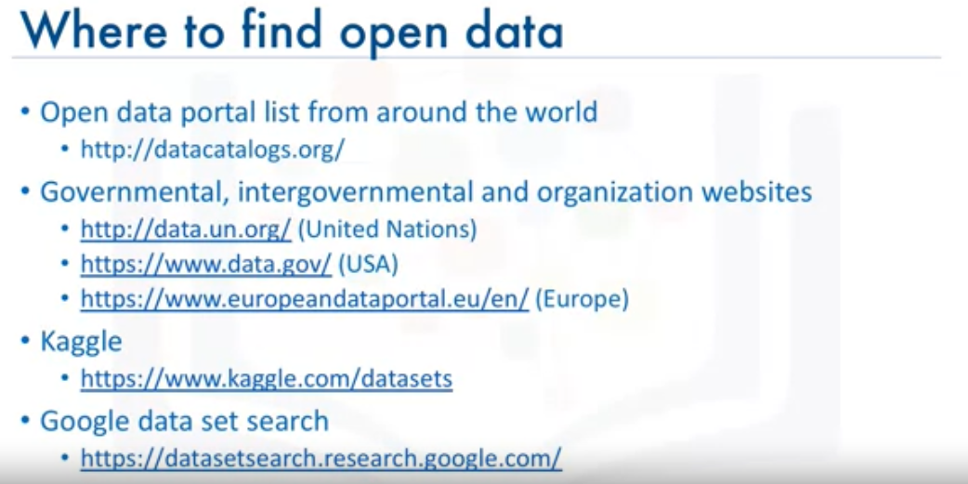


Slide 64



Slide 65

Machine Learning Model

Slide 66


SuperVised Learning
Supervised learning is one of the most commonly used type of machine learning models.
In supervised learning, a human provides input data and the correct outputs.
The model tries to identify relationships and dependencies between the input data and the correct output.
Generally speaking, supervised learning is used to solve regression and classification problems.
Let’s look at an example for each problem type:
Regression models are used to predict a numeric, or “real," value.

Slide 67

Clustering models are used to divide each record of a data set into one of a small number of similar groups.
An example of a clustering model could be providing purchase recommendations for an e-commerce store based on past shopping behavior and the content of a shopping basket.
Anomaly detection identifies outliers in a data set, such as fraudulent credit card transactions or suspicious online log-in attempts.

Slide 68

a reinforcement learning model learns the best set of actions to take, given its current environment, in order to get the most reward over time.
This type of learning has recently been very successful in beating the best human players in games such as go, chess, and popular strategy video games

Slide 69



Slide 70


Slide 71

Model Asset Exchange (MAX)

Slide 72


popular enterprise-grade Kubernetes platform is Red Hat OpenShift, which is available on IBM Cloud, Google Cloud Platform, Amazon Web Services, and Microsoft Azure.

Slide 73


Slide 74


